Slide 1
Arithmetic Operations (Restoring, L-R Shift, Subtraction, etc.)
Operation
Presented By:
Md. Rahul Islam Joy 212902070
Sajid Rahman Rifan 212902017

Slide 2
Index
Theoretical Implementation
Introduction
Algorithm
Program
Execution
Flow Chart
Conclusion

Slide 3
Introduction
The Arithmetic Operations Implementation project aims to develop a program or system that can perform various arithmetic operations, such as addition, subtraction, multiplication, and division. The project focuses on implementing several key arithmetic algorithms, including restoring division, left-right shifting, and subtraction.

Slide 4
Algorithm
A ← 0, M ← Divisor, Q ← Dividend, Count ← N.
Shift A & Q left one binary position.
A ← A-M.
If A is 1,
TRUE
Assign Q₀ ← 0
A ← A+M (Restore)
FALSE
Q₀ ← 1
5. Count ← Count – 1
6. Repeat 1…..n

Slide 5
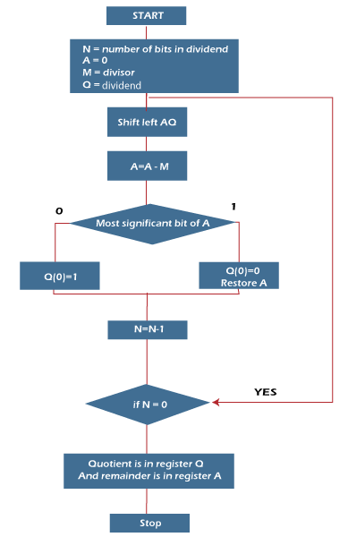
Flow Chart

Slide 6
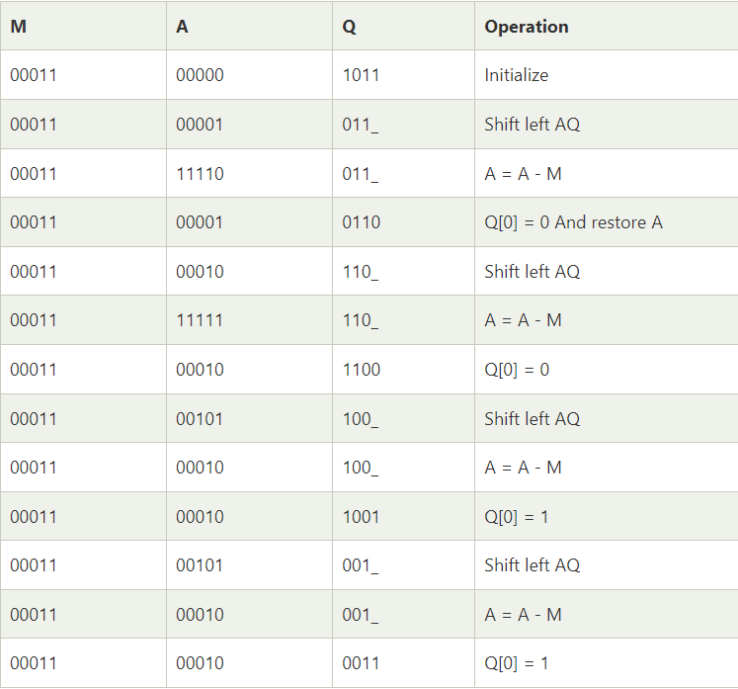
Theoretical Implementation

Slide 7
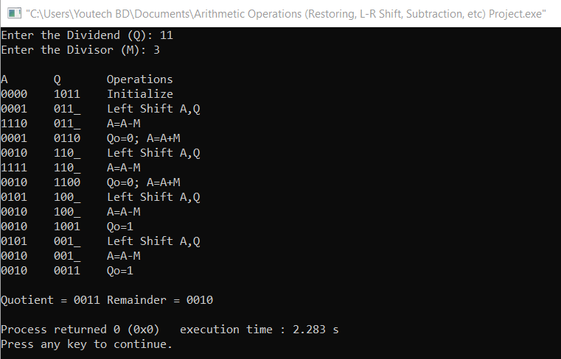
Program Execution

Slide 8
Conclusion
The Arithmetic Operations Implementation project enhances your understanding of arithmetic operations, algorithms, and programming skills. By implementing various arithmetic operations and handling exceptional cases, you have gained practical experience and strengthened your problem-solving abilities.
RESTORING DIVISION IS USUALLY PERFORMED ON THE FIXED POINT FRACTIONAL NUMBERS.
RESTORING ALGORITHM ARE THE TYPES OF SLOW DIVISION ALGORITHM.

Slide 9
THANK YOU

